Slide 1

The Validity of Conscientiousness is
Moderately Overestimated
Sven Kepes & Michael A. McDaniel
Virginia Commonwealth University
Paper presented to at IPAC conference, July 2013. Columbus, OH

Slide 2
Goals
This talk will address data supporting the conclusion that conscientiousness is less predictive of job performance than we are lead to believe based on the cumulative research.
I frame these findings in the context of challenges to evidence-based practice in personnel selection.

Slide 3
Evidence to Guide Practice
IPAC is largely composed of practitioners who seek to apply the best evidence when implementing selection systems.
Journals are typically viewed as sources of the best evidence for personnel selection (and all other disciplines).
Personnel selection research is largely published in industrial and organizational psychology (I-O) and management journals.

Slide 4
Growing Concerns
There are growing concerns about the trustworthiness of the literature reported in I-O and management journals.
The primary concern stems from the observation that hypotheses are almost always supported.

Slide 5
Growing Concerns
We argue that researchers are either:
  1) approaching omniscience, or
  2) there are forces at work that cause our journal articles to be unrepresentative of all completed research.

Slide 6
What Journals Publish
Statistically significant results are more likely to get published in our journals than studies with non-significant results.
About 97% of all hypotheses presented are supported.
  Researchers find what they want to find.
  Journals publish significant findings.

Slide 7
Journal Competition
Any given journal is in a competitive market with other journals.
Journals seek to publish “hot findings” because:
  Articles with such findings get cited more often than other articles.
  These citations enhance the reputation of a journal (through metrics such as the impact factor).

Slide 8
Researcher and Academic Program Competition
Researchers and the university academic programs in which they work are in a competitive market.
The highest ranked programs are motivated to stay highly ranked. The lesser ranked programs are motivated to improve their ranking.
Well-cited researchers wish to continue to be well-cited. Lesser cited researchers seek to become well-cited.

Slide 9
Government & Industry Reputations
Researchers in industry and government often wish to document the efficacy of an organization’s I-O practices (e.g., selection systems).
These researchers strive for publications with supported hypotheses in part to serve the commercial or reputational interests of their organizations.

Slide 10
Questionable Research Practices
Researchers have substantial methodological flexibility that can be marshaled to obtain supported hypotheses.
  They can stop data collection, tweak the design or measurement, and discard the original data and collect new data.
  They can drop outliers or other observations that diminish the magnitude of the research findings (e.g., validity).

Slide 11
Questionable Research Practices
Researchers can delete variables that “didn’t work out” and retain variables that “worked.”
They can collect additional data needed to increase sample size to move a marginally statistically significant effect size (e.g., p < .06) to a significance level that is more acceptable to journals (e.g., p < .05).

Slide 12
Questionable Research Practices
Researchers can also terminate data collection once the preferred statistical significance value (p) value is obtained.
They can abandon the hypotheses that were not supported, reverse the direction of the hypotheses, or create new hypotheses after looking at the results.

Slide 13
Questionable Research Practices
Researchers can then report the results that best support the retained hypotheses in a nice, neat publishable package and never mention the discarded variables, analyses, observations, and hypotheses.

Slide 14
How Much Distortion is in the Literature?
O’Boyle, Banks & Gonzales-Mule (2013, AOM)
  Best Paper Award - Research Methods Division
For the management literature, they tracked changes in hypotheses, data, and results as a manuscript moved from defended dissertation to journal publication.

Slide 15
How Much Distortion in The Literature?
Dissertation to Journal:
  10% added subjects.
  20% dropped subjects.
  33% showed changes in the means, standard deviations, or interrelations of the included variables.
  21% of the unsupported dissertation hypotheses turned into statistically significant journal hypotheses.
  Added hypotheses were nearly twice as likely to be significant as dropped hypotheses (70.0% vs 38.7%).

Slide 16
Current Study

Slide 17
Method
The conscientiousness data analyzed are from Shaffer and Postlethwaite (2012) meta-analysis and include 113 validity coefficients for conscientiousness predicting job performance.
We conducted publication bias analyses.
Publication bias exists to the extent that data available to a reviewer on a topic is not representative of all data on the topic of interest.

Slide 18
Highlights
I can send you the paper with all the details and another paper that explains publication bias analyses.
Here I fill focus on some highlights with pictures.

Slide 19
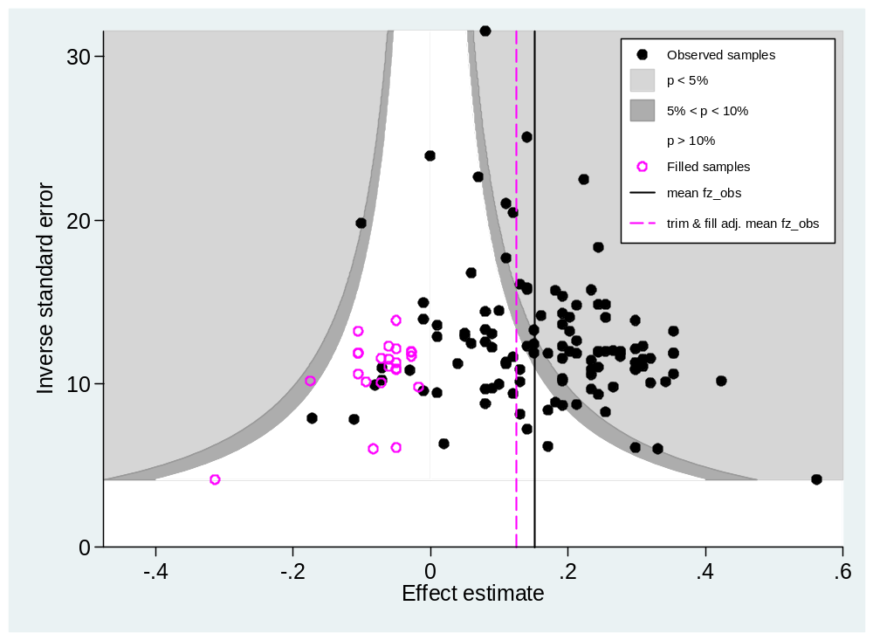
All Sources of Data
Mean observed validity = .16
Trim and fill validity = .13
Selection models validity = between .12 and .14
Validity appears to be overestimated between 13% and 19%

Slide 20
Journal Data has Higher Validity Than Non-Journal Data
A common, but insufficient, publication bias analysis is a comparison of data source (published vs. non-published).
  Mean validity in journal data was .19
  Mean validity in non-journal data was .12
It is useful to look at potential bias within study source.

Slide 21
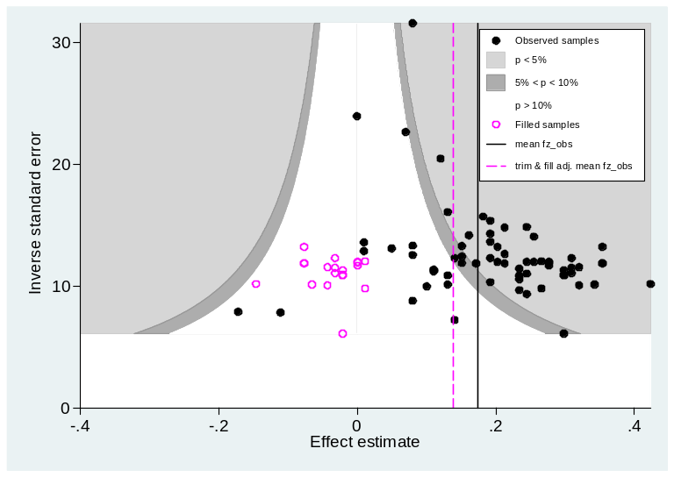
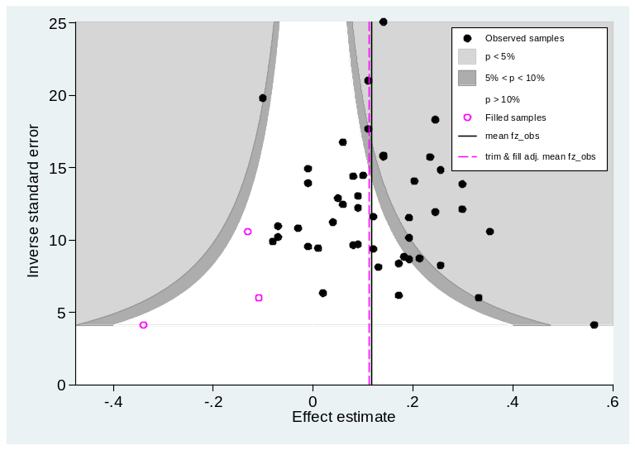
Published vs. Non-published
Published | Non-Published
Trim & Fill .19 vs .14 (26% drop) | Trim & Fill .12 vs .11 (8% drop)
Selection models .19 vs .16 or .17 (11% to 16% drop) | Selection models .12 vs .10 (17% drop)
Publication bias appears larger in the published data than in the unpublished data.

Slide 22
Contextualization
Shaffer and Postlethwaite (2012) compared personality measures that were contextualized vs. non-contextualized.
Contextualized items reference work.
  At work, I keep my commitments.
Non-contextualized items don’t reference a context.
  I keep my commitments.

Slide 23
Contextualization
Validity and Publication Bias
Contextualized conscientiousness measures have higher validity than non-contextualized measures (.19 vs .15).
Little evidence of publication bias was found for contextualized measures.
Most of the publication bias in the journal articles with for non-contextualized measures.

Slide 24
Take-Aways
Our research literature likely has some publication bias due to questionable research practices.
Journals want “hot stuff” and authors tend to accommodate the journals by engaging in questionable research practices.

Slide 25
Take-Aways
Results are consistent with these inferences:
  The literature on the validity of conscientiousness is affected by publication bias.
  Journal articles tend to overestimate the validity of conscientiousness in the prediction of job performance.
  Validity estimates for non-contextualized measures show the most publication bias, particularly in journals.
  Validity estimates for contextualized are relatively free of publication bias.

